Slide 1

Francois Brouet – sep24_continuous_ds
Notes:
Good afternoon, I am pleased to present to you today the results of my Data Science Project

Slide 2
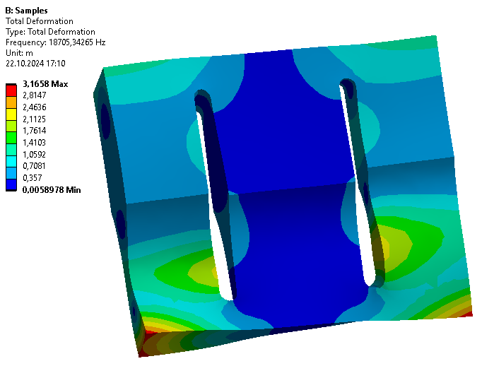
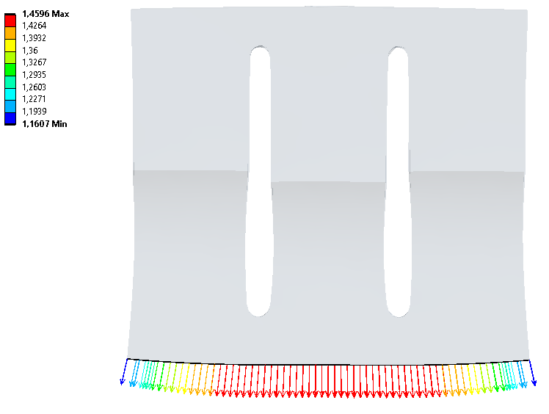
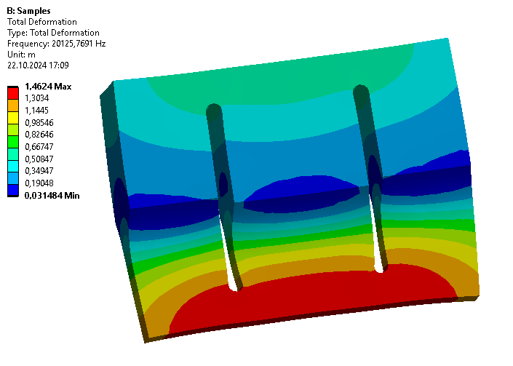

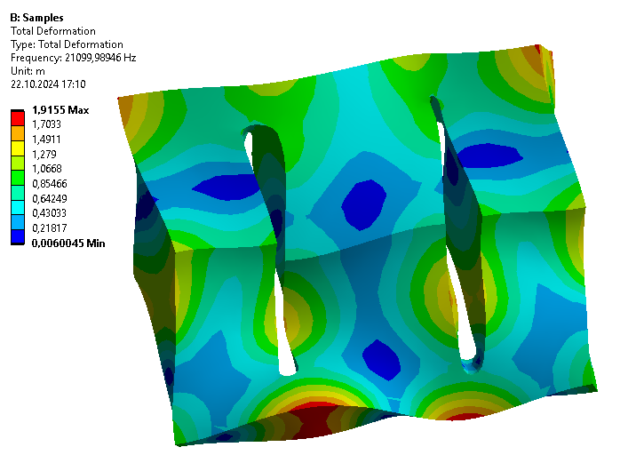
Context
Training Data Scientist
12 months
12 h/week
1 project
Sonotrode design
Requirements of the longitudinal mode:
frequency ~ 20 kHz
longitudinal mode isolated
uniform output displacements
Notes:
Requirements
Longitudinal mode‘s frequency should be close to 20 kHz (driving frequency)
Longitudinal mode should be isolated from other modes
Longitudinal mode‘s displacements should be as uniform as possible over the welding surface

Slide 3
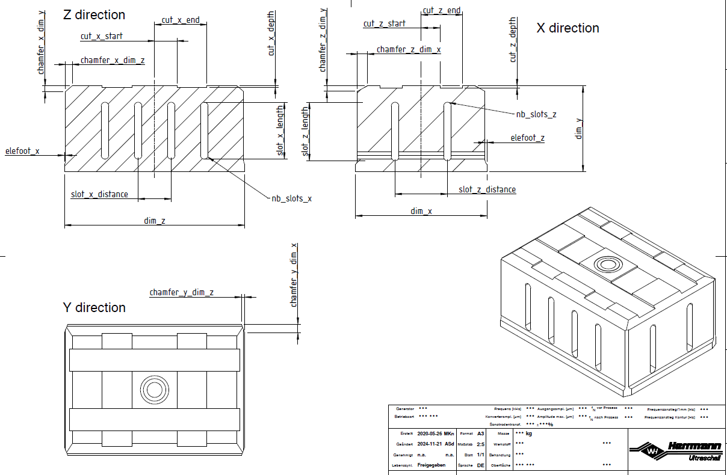
Goal
Main goal: Prediction of the FEM results from the sonotrode geometry
3 predictions:
longitudinal frequency
frequencies of all modes
uniformity of the output displacements
Geometry: 23 parameters
(dim_x) × (dim_z): output surface
(dim_y): length
…
Notes:
Goal of this project was to predict the results of FEM simulations (calculation of modal properties) without running them
Simulations of complex geometries are very computer-intensive → so one iteration can take up to an hour
FEM results are splitted in 3 subgoals (different target variables)
- Prediction of the longitudinal mode’s frequency
- Prediction of the frequencies of all other modes: in particular those near the longitudinal mode (ex: 5 modes below and 5 modes above).
- Prediction of the displacements’ uniformity (as a number), rather than all displacement values
Geometry described by 23 parameters
dim_x / dim_z welding (output) surface, are usually fixed by the welding part
Variation of +/- 5 mm only → local observation first
dim_y: oscillation length, important feature to tune the longitudinal frequency
here: 4 slots and 2 slots in both directions
other dimensions: free, used to optimize the modal properties of the sonotrode

Slide 4
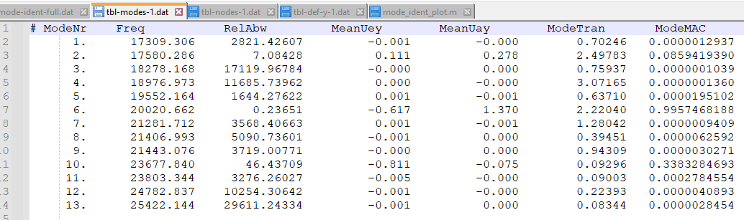
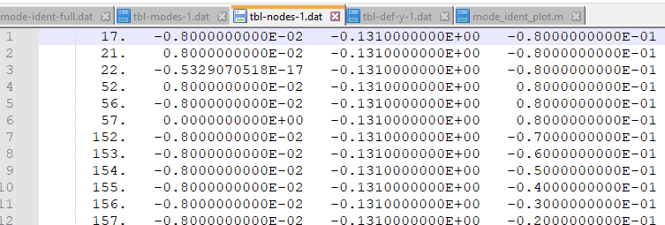
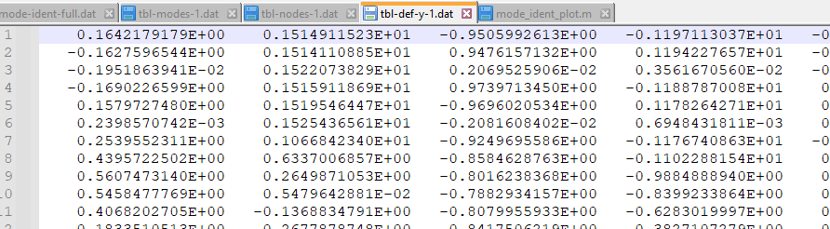
Data exploration
MAC (Modal Assurance Criterion)
comparison: mode shapes with reference longitudinal mode shape
0 no correspondance
1 full correspondance
Identification of the longitudinal mode
Long. mode: highest MAC value
8000 design points (DP) = geometries
CSV files
Notes:
To describe the longitudinal mode‘s displacements:
the MAC value is an indicator, that compares the calculated mode shapes with a reference shape, chosen as an ideal long. mode shape
in a range from 0 (no correspondance with the long. mode shape at alll) to 1 (equals a perfect longitudinal mode shape)
the FEM program directly calculates the MAC value when the simulation is complete
When a simulation is complete and all modes have been calculated, the long. mode is found by comparing the MAC value of each mode.
The mode with the highest value is marked as the long. mode. The mode number can change between 2 geometries.
A design point represents a distinct geometry as a 23-dimensional vector. Before starting the project, I generated the DPs randomly within a defined parameter space, to ensure valid sonotrode geometries.
There are about 8000 DPs. The data was stored in CSV files written by the FEM program.
During the data collection step, I imported the 24,000 CSV files into 4 dataframes, that we will see now

Slide 5
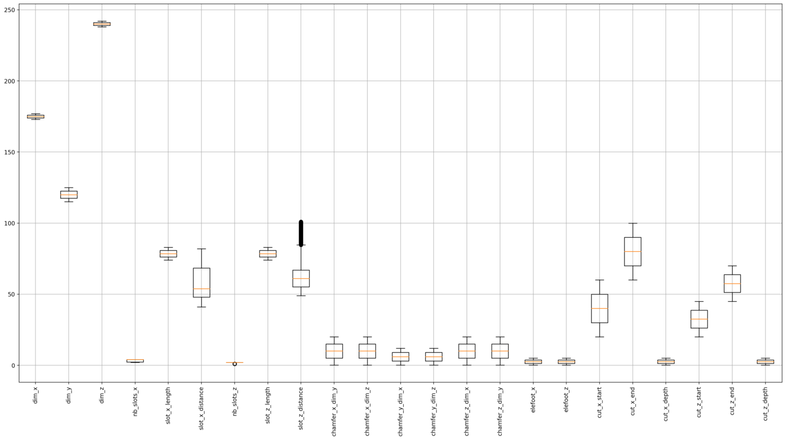
Data visualization
Notes:
* Data visualization
We start with the distribution of the explanatory variables: the geometric parameters are distributed according a normal distribution
slot_x_distance and slot_z_distance have a skew distribution → they are depending on the variable number of slots

Slide 6
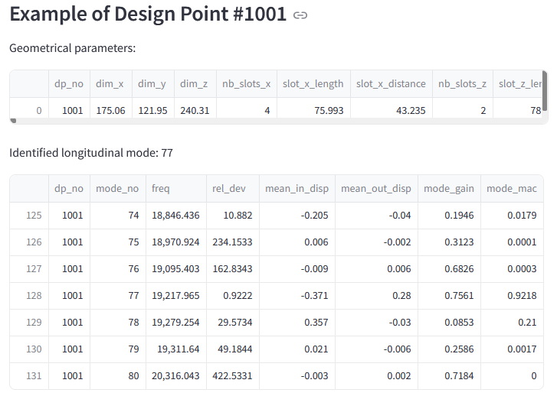
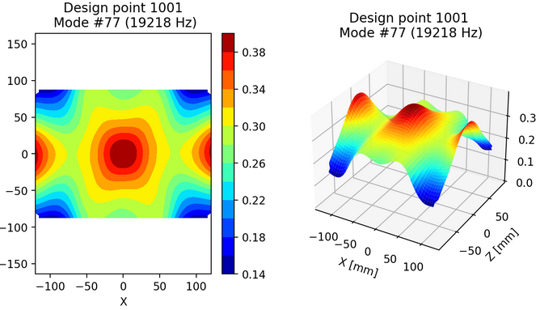
Data visualization
Notes:
Example of DP 1001:
see the geometric parameters
Identified long. mode is mode 77, why?
- In the mode list:
MAC value 0.92 maximal for mode 77
Long. frequency is frequency of mode 77: 19218
Delta frequency to the next mode is only 61 Hz
Displacements of mode 77 are not perfectly uniform (although they have the same sign)

Slide 7
Result overview
Target variable(s) | Best estimator | Final R² score | Mean Absolute Error
Frequency of the longitudinal mode | LightGBM | 0.997 | 21 Hz
All frequencies | LightGBM | 0.998 | 98 Hz
Displacements (NRDD) | Keras Neural Network | 0.822
Displacements (MAC) | LightGBM | 0.693
Displacements (PCA 1st component) | ExtraTrees | 0.273
Notes:
You can see in the overview table the best results achieved for the 3 targets:
Today I will present you the results for the long. frequency and the displacements only
- predictions of the frequencies were performed with the Light Gradient-Boosting Machine algorithm
- prediction of the uniformity (NRDD) was achieved with a Keras Neural Network → NRDD criterion described later
- prediction of the uniformity (MAC) did not performed as well as for (NRDD)
- I tried to reduce the dimensions of the displacement vectors: 400 DOFs → 10 DOFs, and predict the first component

Slide 8

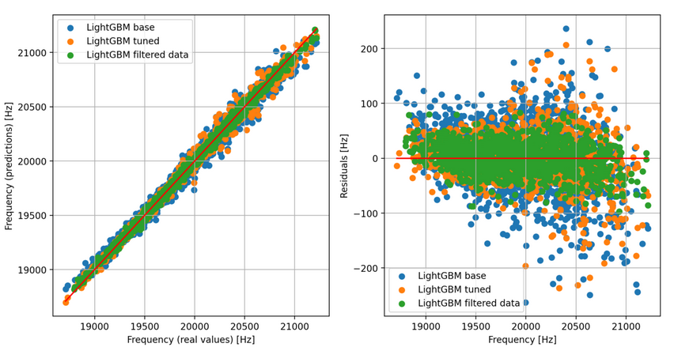
Modelling
Notes:
Here are the results of the model with tuned parameters and filtered data:
- Tuned hyperparameters = external configuration variables that manage the training the ML models. Selected in a grid of acceptable ranges.
- Filetered data: exclude any DP from the training with low MAC values (below 0.75) → maintaining still 85% of the dataset
Finally
- R² score is high
- MAE (arithmetic average of the abs. error) around 21 Hz
In the plots, you can see:
(left) the predicted values = f (real values)
(right) the residuals calculated as difference (Prediction – Real)

Slide 9
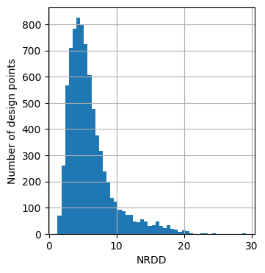
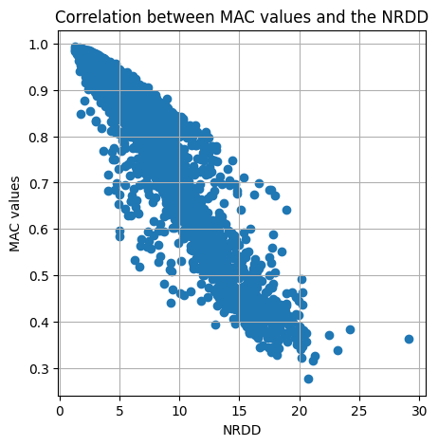
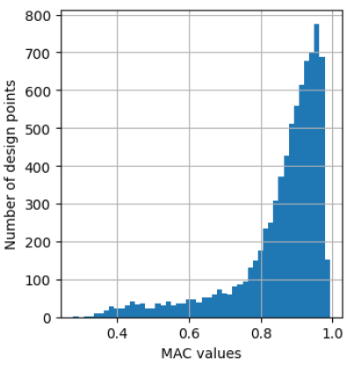




Pre-processing
NRDD
Norm of the Relative Displacement Deviation
$$NRDD= \sqrt{\sum_{n=1}^{N}{{\left(\frac{u_{n}−\overline{u}}{\overline{u}}\right)}^{2}}}$$
$$u_{n}$$
displacement of the node n
average of all displacements
number of nodes (output surface)
$$\overline{u}$$
$$N$$
Notes:
For the displacements I added a new feature called NRDD:
The prediction of the output displacements themselves did not turn out accurate. Since the 3rd goal is to predict only the uniformity, I introduced a new metric to evaluate the displacements‘ uniformity.
The Norm of the Relative Displacement Deviation (called NRDD) is obtained:
by taking the relative difference of each node‘s displacements and the average
squarring and summing these differences
taking the square root of the result
A low value of NRDD corresponds to uniform displacements, while high values indicate poor uniformities (the deviations are significant)
The graphs show
the distribution of NRDD and MAC
the correlation between the MAC values and the new metric NRDD
I chose the NRDD as target variable, rather than MAC: the models performed slightly better with NRDD than with MAC.

Slide 10
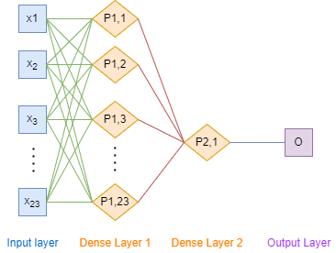
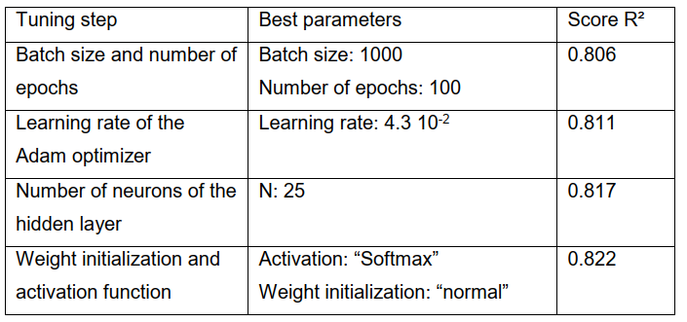
Modelling NRDD
NRDD value as target variable Neural network
Notes:
The baseline neural network model has a first layer with as much 27 neurons (same number as the explanatory variables: geometry + slot distribution)
Algorithm: Adam optimization
Loss function: Mean squared error
Activation function (controls the non-linearity) for the first hidden layer only
The tuning of the neural network topology was tuned in many steps. Each step uses the best parameters from the previous one.
I obtained the best R² score of around 0.82

Slide 11
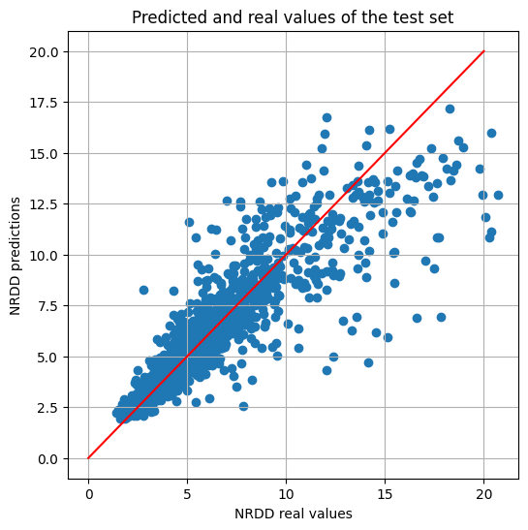
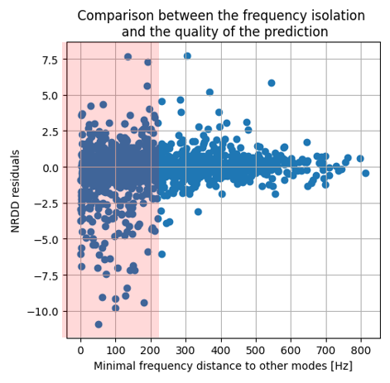
Modelling NRDD
Predictions on the test set (Residuals)
Notes:
The left diagramm shows the comparison of predictions to actual values. The model performs better on low values.
Right diagramm:
The minimal frequency distance corresponds to the smallest frequency gap between the long. mode and ist 2 neighbors (minimum value óf both distances)
When the long. frequency is isolated, the redisuals become smaller

Slide 12
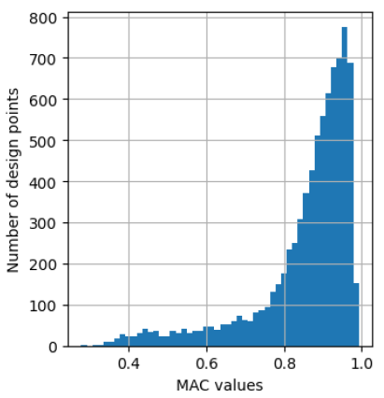
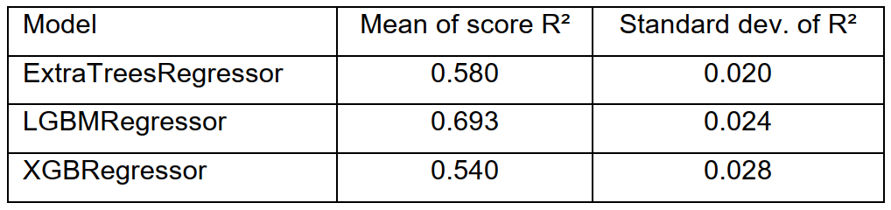
Modelling MAC
MAC value as target variable
Notes:
The histogram tells us that the most frequent MAC value was located around 0.95
The best score was 0.69

Slide 13
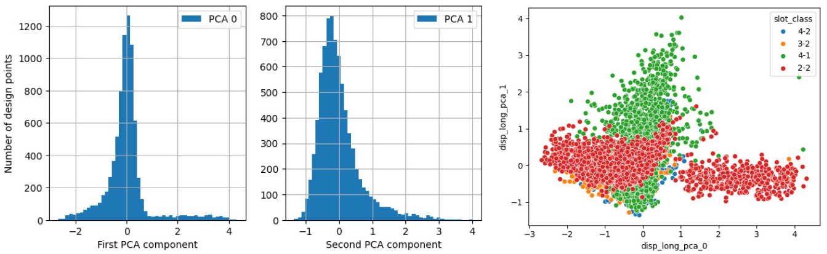
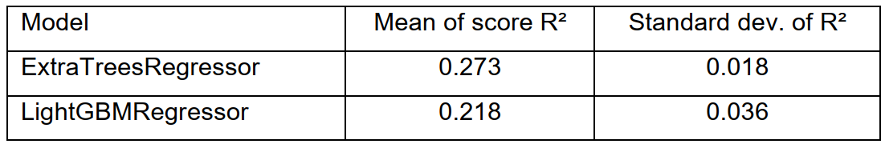
Modelling PCA components
First PCA component as target variable
Notes:
PCA: Principal Component Analysis reduce the number of variables.
Usually used to reduce the number of input variables, but here used for the target variables.
The data was mapped into a 10 dimensional vector space → keep more than 95% of the information
The prediction of the subset of displacements did not show satisfactory results. But shows high potential, unfortunately I could‘nt invest more time in that direction

Slide 15
Presentation
01
Context
02
Data exploration
03
Data visualization
04
Pre-processing
05
Result overview
06
Modelling
07
Next steps / Conclusion
Notes:
The presentation will be divided in the following sections: I will show you some elements in the slides and then at some points of the presentation, we will switch to streamlit
After a short introduction we will have a look at:
the data
the targets
the models
and finish with an outlook for the project

Slide 16
Next steps & Conclusion
Optimizer
Navigation with the models
Cost functions
cost_long_freq
cost_all_freq
cost_nrdd
cost_total
scipy.differential_evolution
scipy.minimize
Notes:
I have completed the results‘ presentation and would like to mention the next steps:
- to deploy the model in a business point of view: we will need an optimizer
* to find the optimal geometry (or geometries)
* the optimizer will work with the predictions and navigate more efficiently in the parameter space, than the FEM simulations would
(click)
* I will define three cost functions for each target + combine them to build a total cost to be minimized
(click)
* I will start by exploring a large area of candidate space + then use a gradient-based minimizer for a fine-tuning

Slide 17
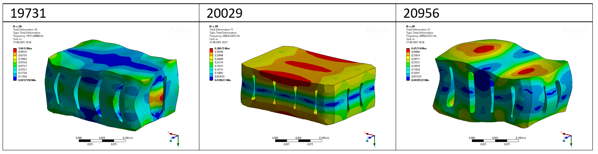
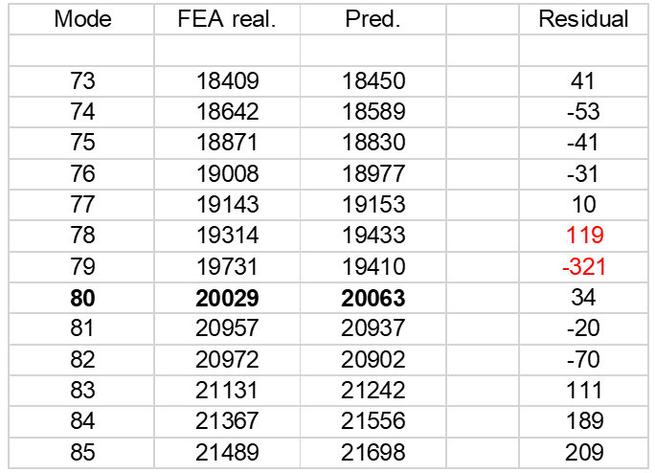
Optimizer
Lösung 1
Vergleich Vorhersage / Reale Werte

Slide 18
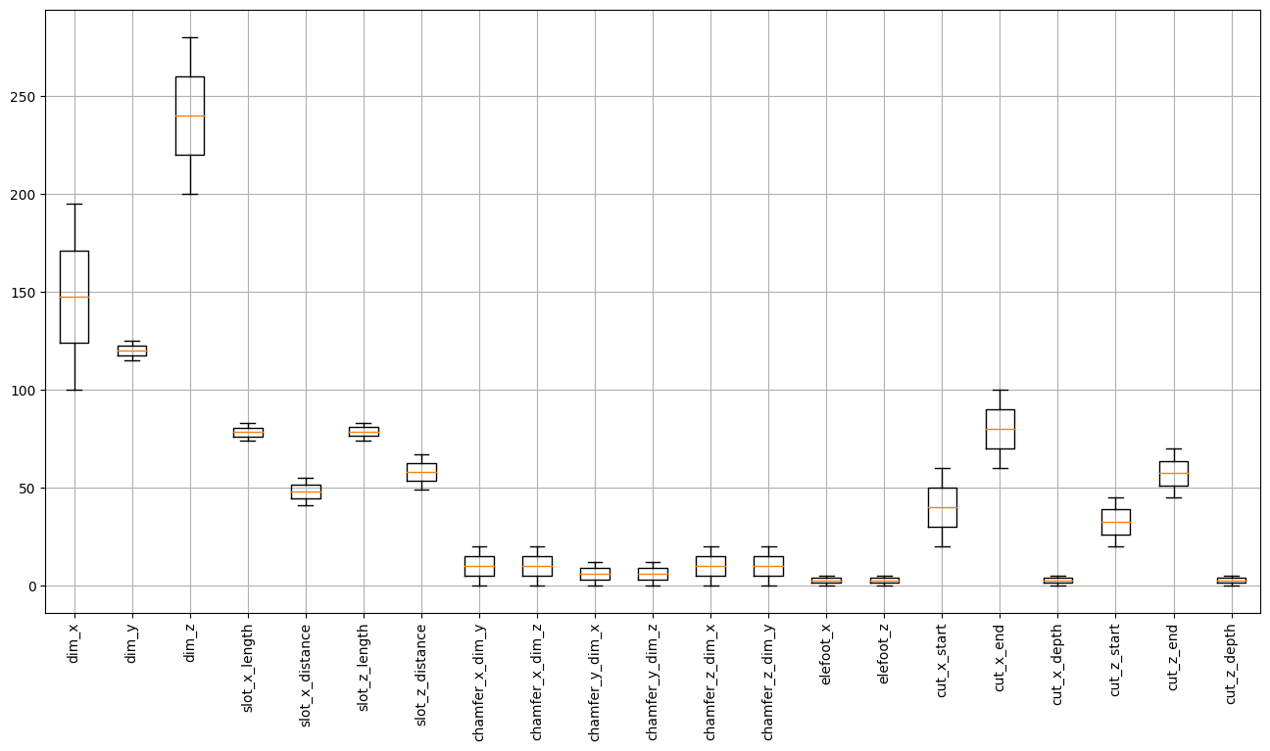
Breiterer Bereich
Variationsbereich mit konstanter Schlitzverteilung:
dim_X: 100 – (175) – 195 2 Schlitze
dim_Z: 200 – (240) – 280 4 Schlitze

Slide 19
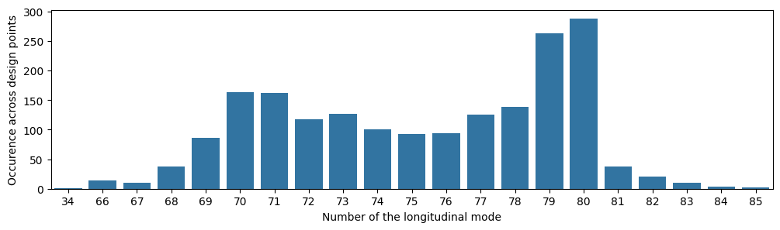
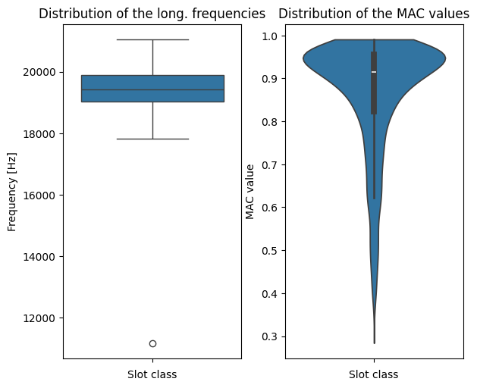
Breiterer Bereich
Verteilung der Längsmoden
Long. Frequenzen
+ MAC-Werte

Slide 20
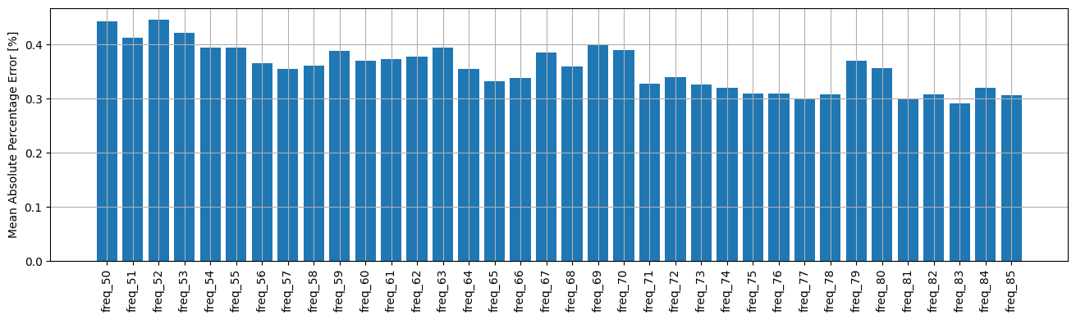
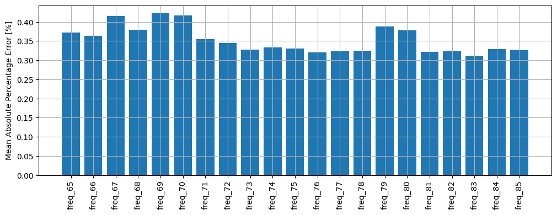
Vergleich der Performances
Alle Frequenzen
Schmaller Bereich Breiter Bereich
NRDD
Schmaller Bereich Breiter Bereich

Slide 21
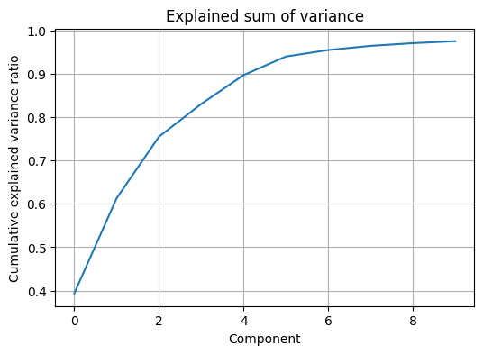
Dimensionsreduktion
PCA (Principal Component Analysis)
→ transformiert korrelierte Variablen in neue, unkorrelierte Variablen
Verschiebungen der 400 Knoten → 10 Komponenten

Slide 22
Dimensionsreduktion
Nutzen aus der Weiterbildung
1) Materialparameterermittlung
Skalierung / Transformation der Variablen
Globaler + Lokaler Optimizer
Clustering Method für die Modenzuordnung
Idee: Expl. und Target Variablen tauschen
Eigenfrequenzen sind die Eingaben
Gesucht werden die Materialkonstanten
2) Streamlit – Einfache GUI
Eingabeparameter
Datenvisualisierung

